Slide 1
MINI-PROJECT
ANALYSIS ON KICKSTARTER PROJECTS DATASET
Animesh Gautam

Slide 2
INDEX
About the dataset
Kickstarter
Talend ETL Tool
Cleaning of dataset
Analysis

Slide 3
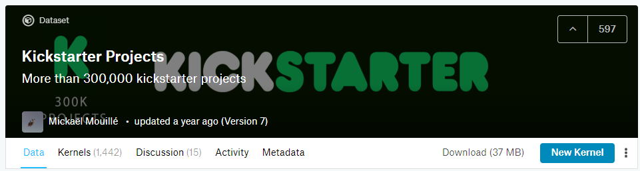
About the dataset
Source: Kaggle
Content: Each row has values for Project-IDs, project-names, country, launch-dates, amount pledged, deadlines, goal-amount, no. of backers, state of the project, categories & sub-categories to which the project belongs to.

Slide 4
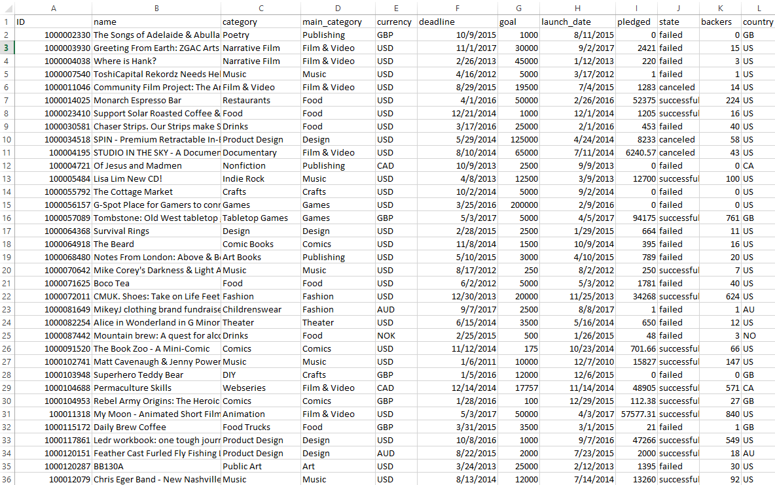

Slide 5
Kickstarter
Kickstarter is an American public-benefit corporation based in Brooklyn, New York, that maintains a global crowd funding platform focused on creativity and merchandising. The company's stated mission is to "help bring creative projects to life". Kickstarter has reportedly received more than $4 billion in pledges from 15.5 million backers to fund 257,000 creative projects, such as films, music, stage shows, comics, journalism, video games, technology and food-related projects.

Slide 6

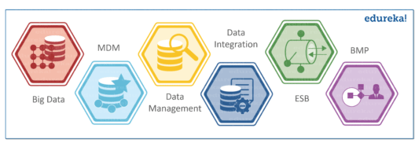
TALEND ETL TOOL
Talend is an open source data integration platform. It provides various software and services for data integration, data management, enterprise application integration, data quality, cloud storage and Big Data.

Slide 7
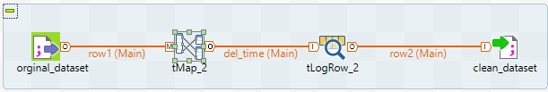
CLEANING OF THE DATASET
Created Metadata of the original dataset on Talend
Got rid of the dates given alongside the launch date in the same column to avoid discrepancies

Slide 8
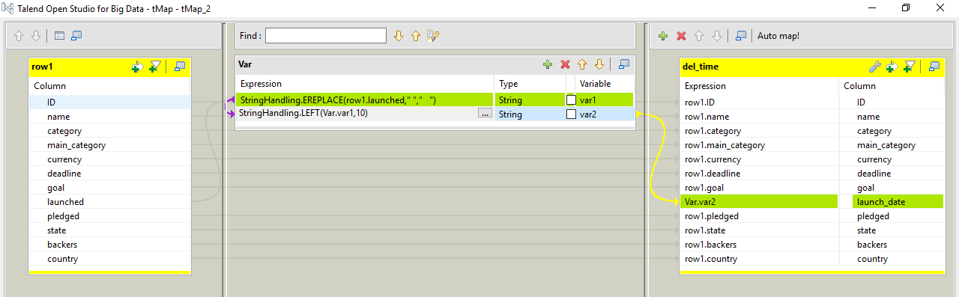

Slide 9
Analysis

Slide 10
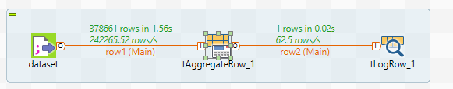
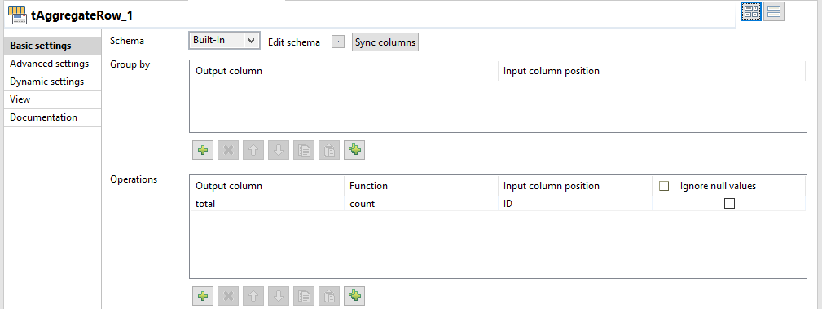

1. Total number of projects in the Kickstarter Dataset

Slide 11
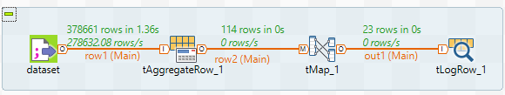
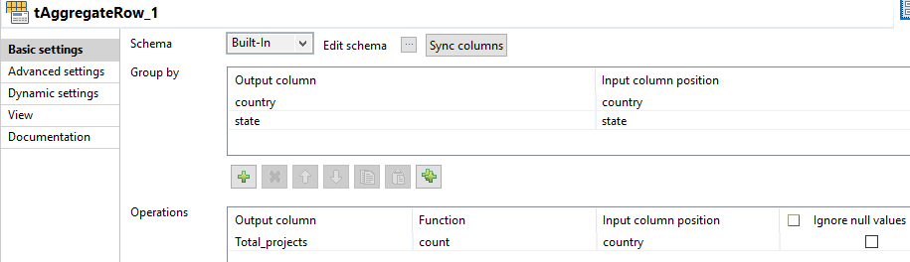
2. Total number of projects and successful projects from each country

Slide 12
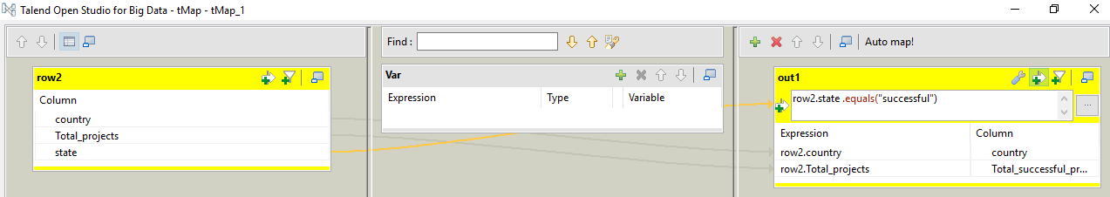
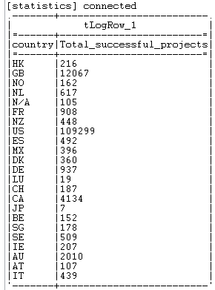

Slide 13
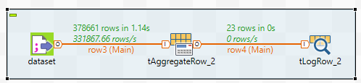
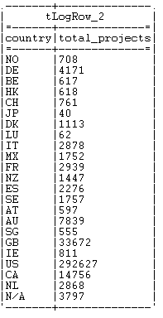
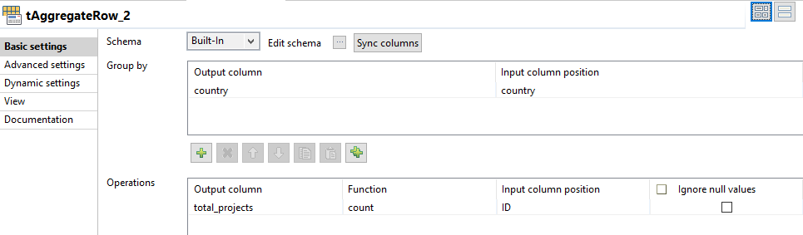

Slide 14
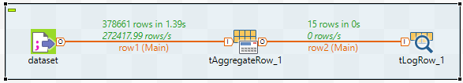
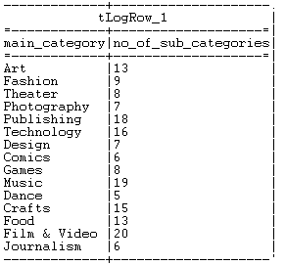
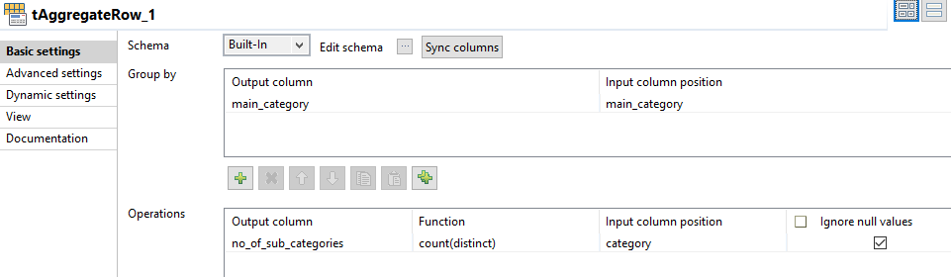
3. The various main categories and no. of sub-categories under each category

Slide 15
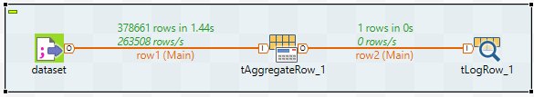
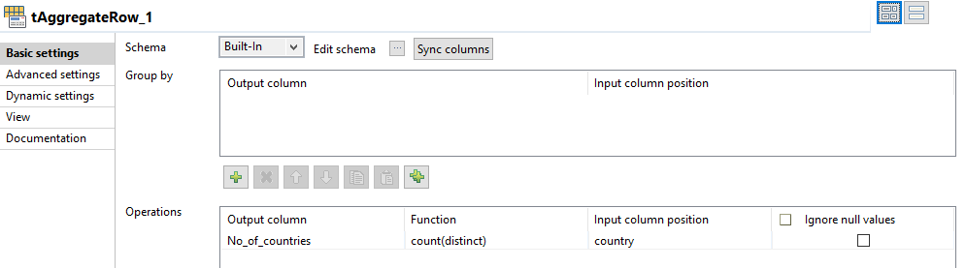

4. Total number of countries involved in the Kickstarter Program

Slide 16

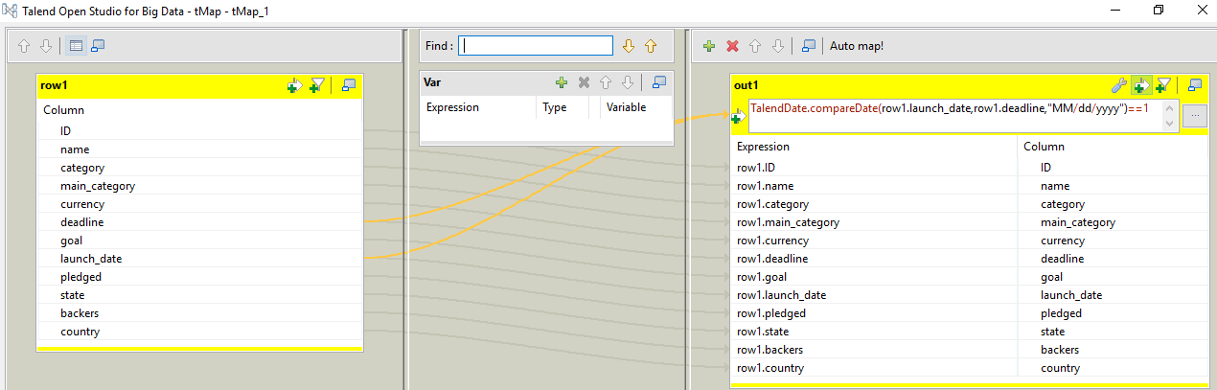
5. Projects which were launched after the deadline

Slide 17
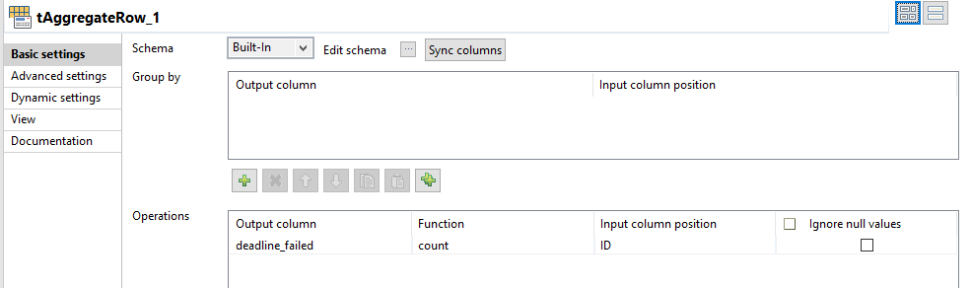


Slide 18
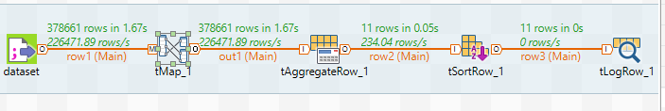
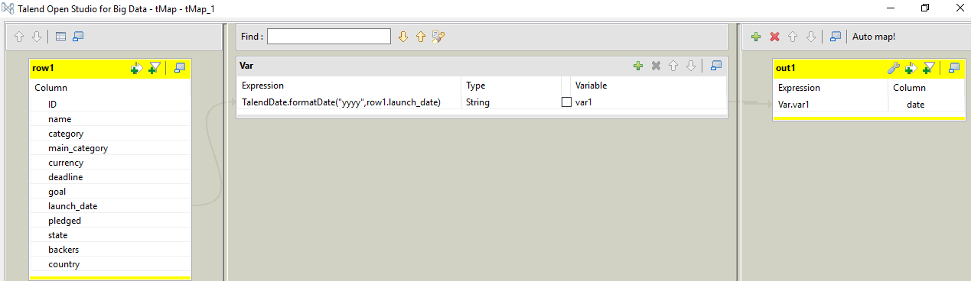
6. Number of projects launched year-wise

Slide 19
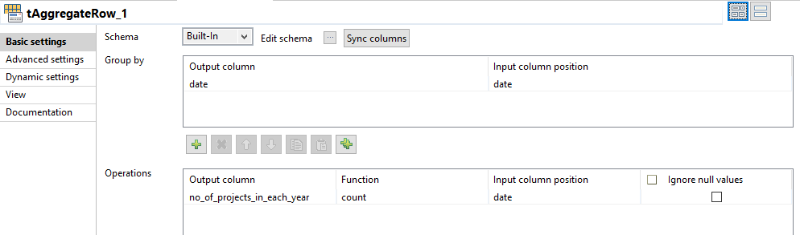
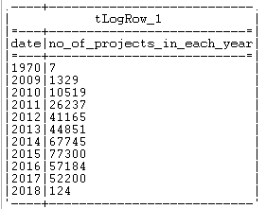
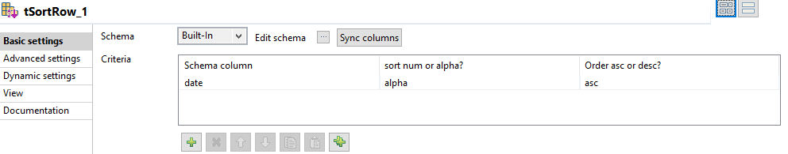

Slide 20
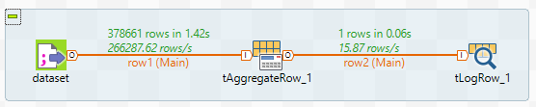
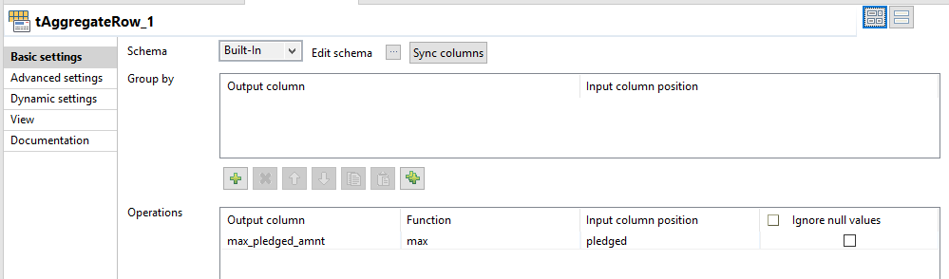

7. The maximum pledged amount received by a Kickstarter Project

Slide 21
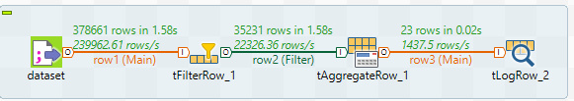
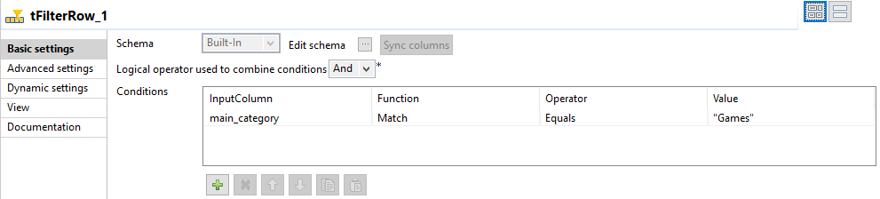
8. Number of projects from the main category ‘Games’ from each country `

Slide 22
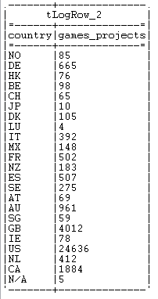
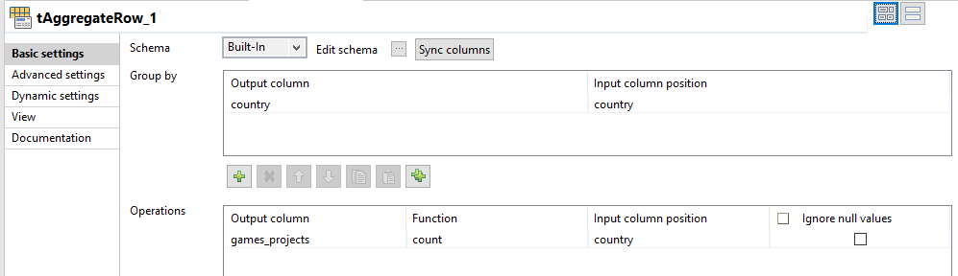

Slide 23
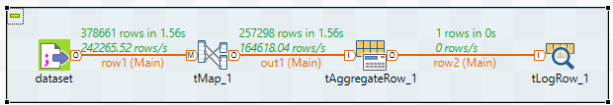
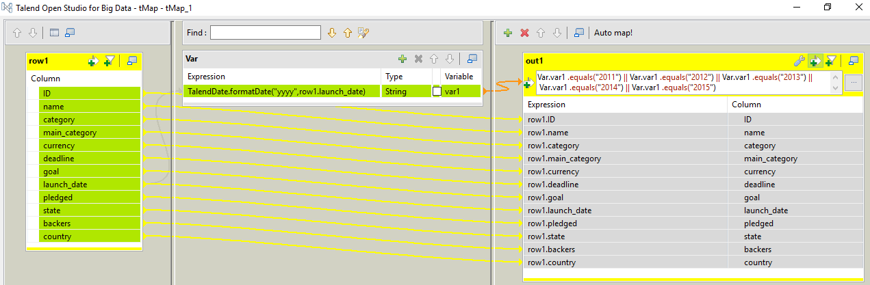
9. Number of projects launched between 2011 & 2015

Slide 24
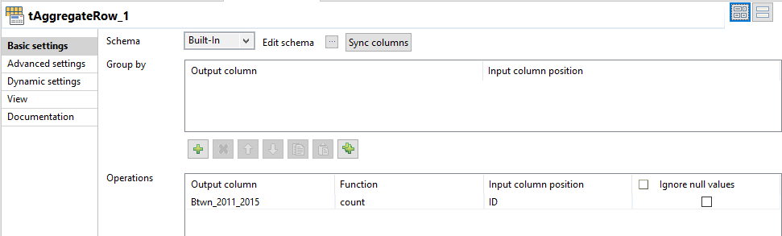


Slide 25
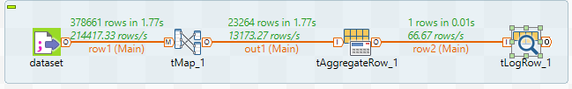
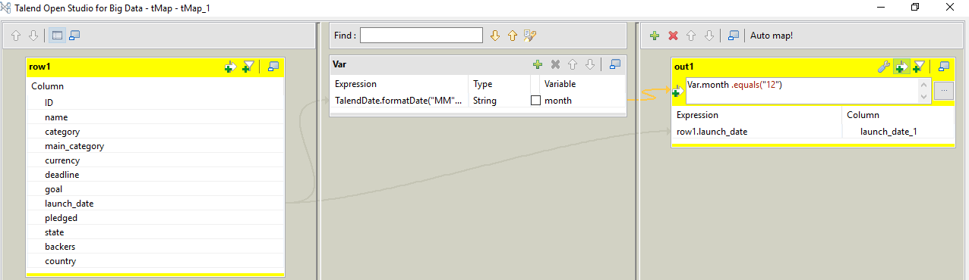
10. Number of projects which were launched in the month of December

Slide 26
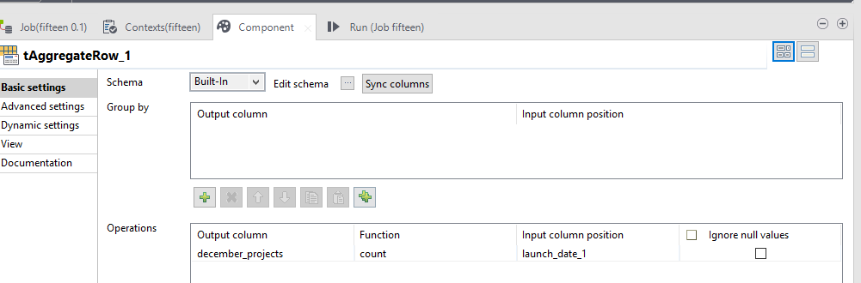


Slide 27
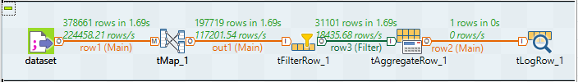
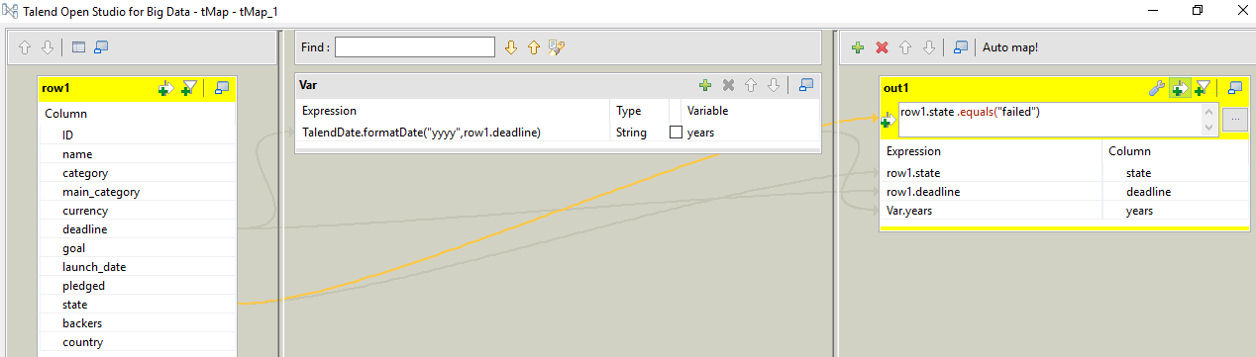
11. Number of projects that failed to meet the deadline in 2016

Slide 28
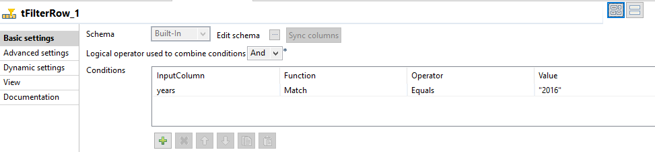

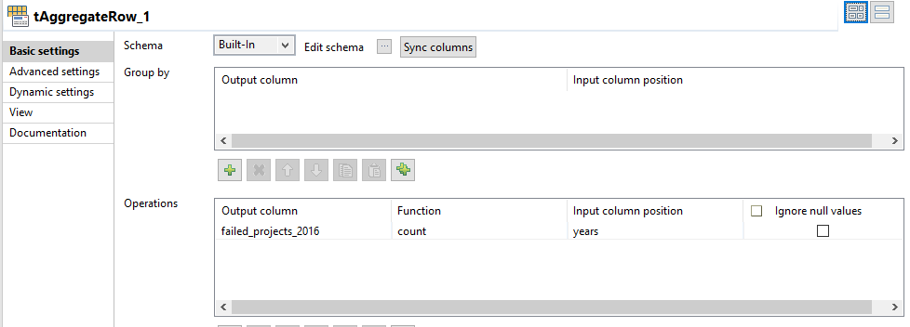

Slide 29
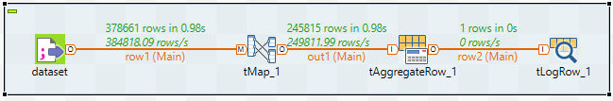
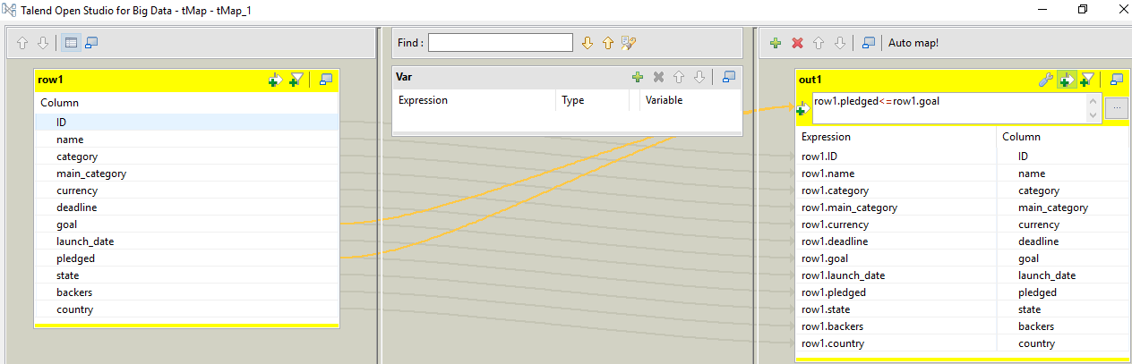
12. Number of projects that didn’t meet their goal amount

Slide 30
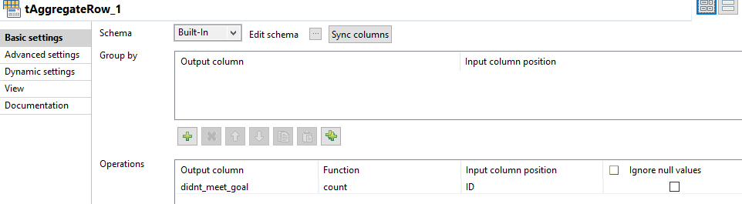


Slide 31
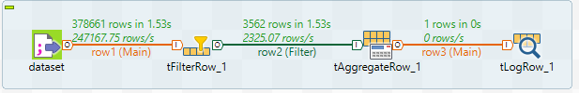
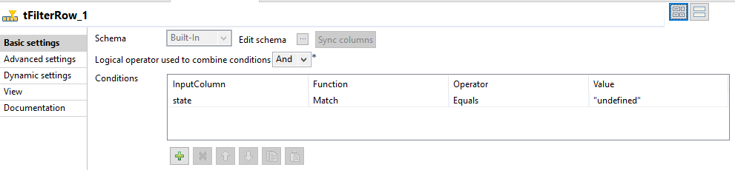
13. Number of projects with an Undefined Status

Slide 32
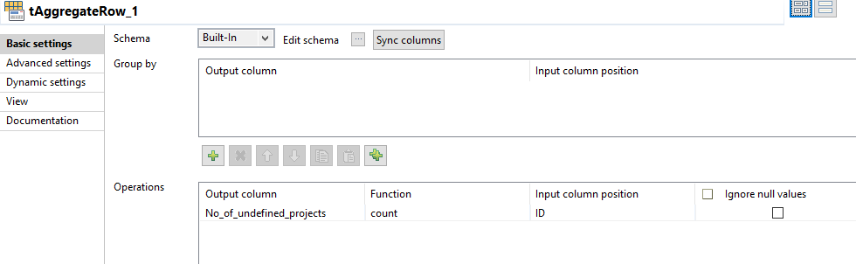


Slide 33
Thank You

